Slide 1
CLASSIFICATION TREES

Slide 2
BACKGROUND
Decision tree (DT) is one of the most popular machine learning algorithms used for both classification and regression problems. Today we are going to talk about the use of DT for classification, so let’s get started!!!
We have couple of other algorithms there, so why do we have to choose Decision trees?? Well, there might be many reasons but I believe a few of which are
Decision tress often mimic the human level thinking so its so simple to understand the data and make some good interpretations.
Decision trees actually make you see the logic for the data to interpret(not like black box algorithms like SVM,NN,etc..)

Slide 3
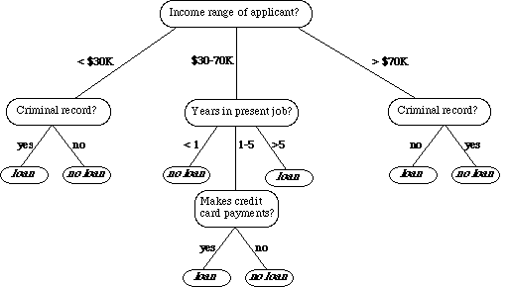
WHAT DOES IT LOOK LIKE ?
As it is shown on the left, DT which is used for classifying bank loan application for a customer may look like this.
Here we can see the logic how it is making the decision. It’s simple and clear.
A DT is a tree where each node represents a feature(attribute), each link(branch) represents a decision(rule) and each leaf represents an outcome
The whole idea is to create a tree like this for the entire data and process a single outcome at every leaf.

Slide 4
SOME OF ALGORITHMS
There are couple of algorithms there to build a decision tree , we only talk about a few which are
ID3 (Iterative Dichotomiser 3) → uses Entropy function and Information gain as metrics.
CART (Classification and Regression Trees) → uses Gini index(Classification) as metric.
Lets just first build decision tree for classification problem using above ID3 algorithm.

Slide 5
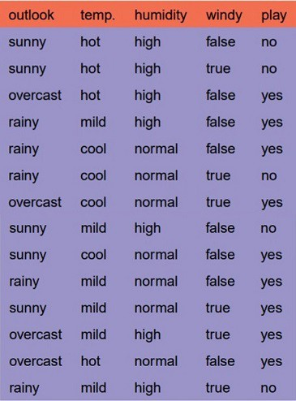
ID3 ALGORITHM : EXAMPLES
We have four X values (outlook, temp, humidity and wind) being categorical and one y value (play Y or N) also being categorical.
So we need to learn the mapping (what machine learning always does) between X and y.
This is a binary classification problem, lets build the tree using the ID3 algorithm
To create a tree, we need to have a root node first and we know that nodes are features/attributes
So which one do we need to pick first??

Slide 6
ID3 ALGORITHM : EXAMPLES
1.Compute the entropy for data-set
2.for every attribute/feature:
calculate entropy for all categorical values
take average information entropy for the current attribute
calculate gain for the current attribute
3. pick the highest gain attribute.
4. Repeat until we get the tree we desired.

Slide 7
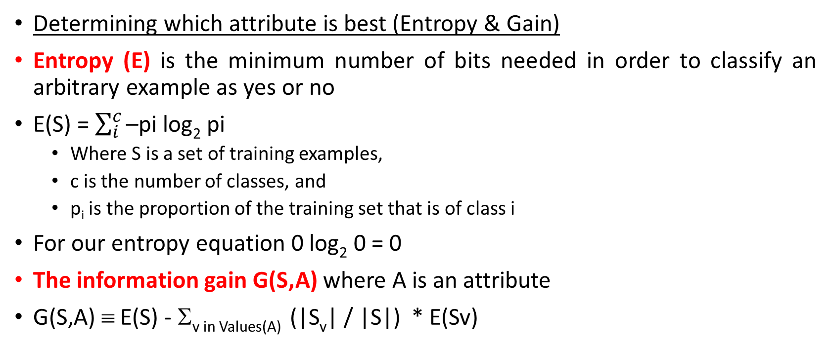
ID3 ALGORITHM : EXAMPLES
Determining which attribute is best (Entropy & Gain)
Entropy (E) is the minimum number of bits needed in order to classify an arbitrary example as yes or no
E(S) = $\sum_{i}^{c}{\text{–}\text{pi} \text{log}\text{2} \text{pi}}$
Where S is a set of training examples,
c is the number of classes, and
p_{i} is the proportion of the training set that is of class i
For our entropy equation 0 log₂ 0 = 0
The information gain G(S,A) where A is an attribute
G(S,A) ≡ E(S) - Σ_{v in Values(A)} (|S_{v}| / |S|) * E(Sv)

Slide 8
Let’s Try an Example!
Let
E([X+,X-]) represent that there are X positive training elements and X negative elements.
Therefore the Entropy for the training data, E(S), can be represented as E([9+,5-]) because of the 14 training examples 9 of them are yes and 5 of them are no.
Let’s start off by calculating the Entropy of the Training Set.
E(S) = E([9+,5-]) = (-9/14 log₂ 9/14) + (-5/14 log₂ 5/14) = 0.94
Next we will need to calculate the information gain G(S,A) for each attribute A where A is taken from the set {Outlook, Temperature, Humidity, Wind}.
The information gain for Outlook is:
G(S,Outlook) = E(S) – [5/14 * E(Outlook=sunny) + 4/14 * E(Outlook = overcast) + 5/14 * E(Outlook=rain)]
G(S,Outlook) = E([9+,5-]) – [5/14*E(2+,3-) + 4/14*E([4+,0-]) + 5/14*E([3+,2-])]
G(S,Outlook) = 0.94 – [5/14*0.971 + 4/14*0.0 + 5/14*0.971]
G(S,Outlook) = 0.246

Slide 9
The information gain for Temperature:
G(S,Temperature) = 0.94 – [4/14*E(Temperature=hot) + 6/14*E(Temperature=mild) + 4/14*E(Temperature=cool)]
G(S,Temperature) = 0.94 – [4/14*E([2+,2-]) + 6/14*E([4+,2-]) + 4/14*E([3+,1-])]
G(S,Temperature) = 0.94 – [4/14 + 6/14*0.918 + 4/14*0.811]
G(S,Temperature) = 0.029
The information gain for Humadity:
G(S,Humidity) = 0.94 – [7/14*E(Humidity=high) + 7/14*E(Humidity=normal)]
G(S,Humidity = 0.94 – [7/14*E([3+,4-]) + 7/14*E([6+,1-])]
G(S,Humidity = 0.94 – [7/14*0.985 + 7/14*0.592]
G(S,Humidity) = 0.1515
The information gain for Windy:
G(S,Windy) = 0.94 – [8/14*0.811 + 6/14*1.00]
G(S,Windy) = 0.048

Slide 10
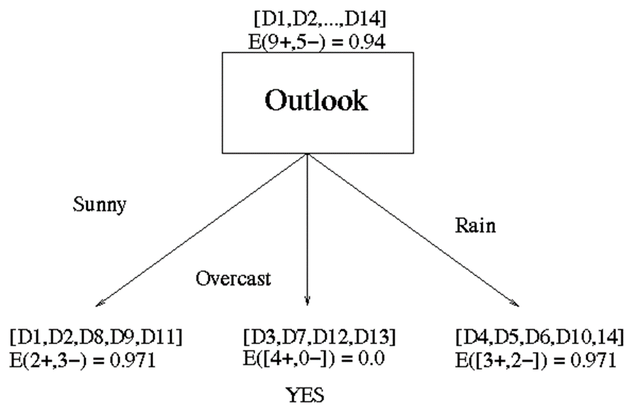
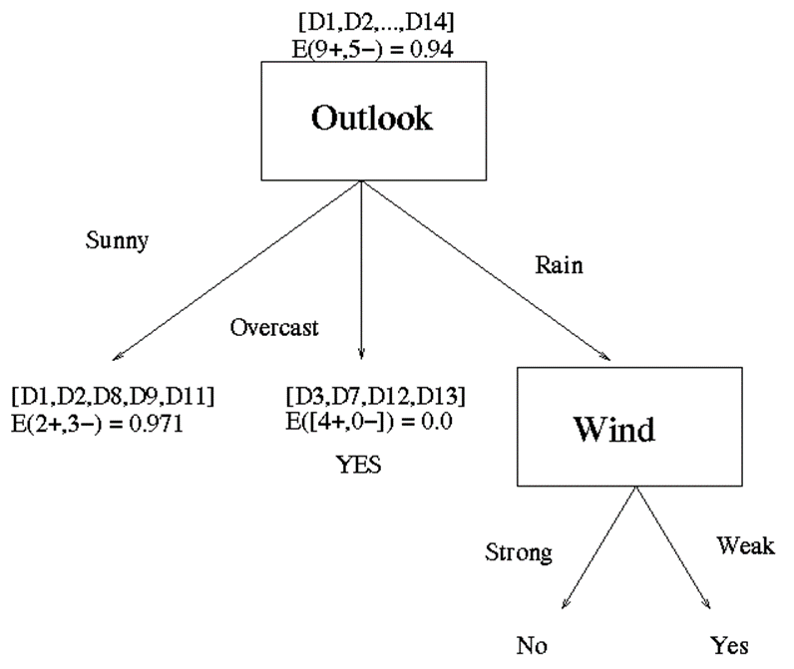
Outlook is the winner
Now that we have discovered the root of our decision tree we must now recursively find the nodes that should go below Sunny, Overcast, and Rain.
G(Outlook=Rain, Humidity) = 0.971 – [2/5*E(Outlook=Rain & Humidity=high) + 3/5*E(Outlook=Rain & Humidity=normal]
G(Outlook=Rain, Humidity) = 0.02
G(Outlook=Rain,Windy) = 0.971- [3/5*0 + 2/5*0]
G(Outlook=Rain,Windy) = 0.971

Slide 11
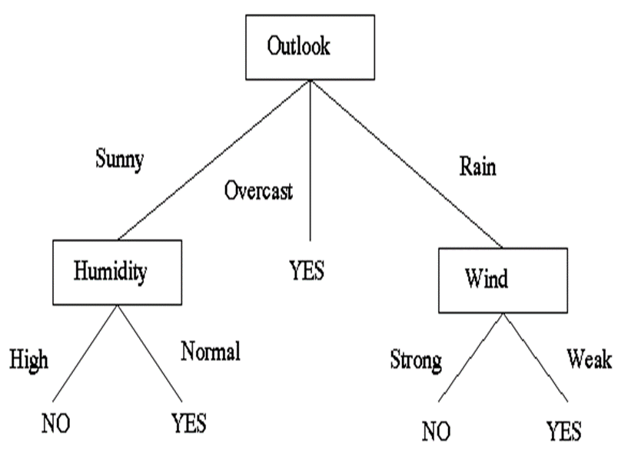
(Outlook = Sunny ∧ Humidity = Normal) ∨ (Outlook = Overcast) ∨ (Outlook = Rain ∧ Wind = Weak)
[See: Tom M. Mitchell, Machine Learning, McGraw-Hill, 1997]

Slide 12
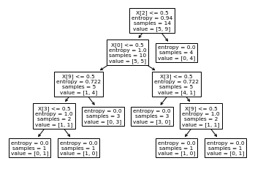

Slide 13
GINI INDEX : Measure of Impurity
Gini Index for a given node t :
(NOTE: p( j | t) is the relative frequency of class j at node t).
Maximum (1 - 1/n_{c}) when records are equally distributed among all classes, implying least interesting information
Minimum (0.0) when all records belong to one class, implying most interesting information

Slide 14
Examples for computing GINI
P(C1) = 0/6 = 0 P(C2) = 6/6 = 1
Gini = 1 – P(C1)² – P(C2)² = 1 – 0 – 1 = 0
P(C1) = 1/6 P(C2) = 5/6
Gini = 1 – (1/6)² – (5/6)² = 0.278
P(C1) = 2/6 P(C2) = 4/6
Gini = 1 – (2/6)² – (4/6)² = 0.444

Slide 15
Splitting Based on GINI
When a node p is split into k partitions (children), the quality of split is computed as,
where, n_{i} = number of records at child i,
n = number of records at node p.

Slide 16
Binary Attributes: Computing GINI Index
Splits into two partitions
Effect of Weighing partitions:
Larger and Purer Partitions are sought for.
B?
Yes
No
Gini(N1) = 1 – (5/6)² – (2/6)² = 0.194
Gini(N2) = 1 – (1/6)² – (4/6)² = 0.528
Node N1
Node N2
Gini(Children) = 7/12 * 0.194 + 5/12 * 0.528 = 0.333

Slide 17
Categorical Attributes: Computing Gini Index
For each distinct value, gather counts for each class in the dataset
Use the count matrix to make decisions
Multi-way split
Two-way split
(find best partition of values)

Slide 18
Continuous Attributes: Computing Gini Index
Use Binary Decisions based on one value
Several Choices for the splitting value
Number of possible splitting values = Number of distinct values
Each splitting value has a count matrix associated with it
Class counts in each of the partitions, A < v and A ≥ v
Simple method to choose best v
For each v, scan the database to gather count matrix and compute its Gini index
Computationally Inefficient! Repetition of work.

Slide 19
Continuous Attributes: Computing Gini Index
For efficient computation: for each attribute,
Sort the attribute on values
Linearly scan these values, each time updating the count matrix and computing gini index
Choose the split position that has the least gini index
Sorted Values
Split Positions

Slide 20
More examples on hand-calculations. Let’s try Var1 == 1 and Var2 >=32.
Var 1 == 1
Baseline of Split: Var1 has 4 instances (4/10) where it’s equal to 1 and 6 instances (6/10) where it’s equal to 0.
For Var1 == 1 & Class == A: 1 / 4 instances have class equal to A.
For Var1 == 1 & Class == B: 3 / 4 instances have class equal to B.
Gini Index here is 1-((1/4)^2 + (3/4)^2) = 0.375
For Var1 == 0 & Class== A: 4 / 6 instances have class equal to A.
For Var1 == 0 & Class == B: 2 / 6 instances have class equal to B.
Gini Index here is 1-((4/6)^2 + (2/6)^2) = 0.4444
We then weight and sum each of the splits based on the baseline / proportion of the data each split takes up.
4/10 * 0.375 + 6/10 * 0.444 = 0.41667
Class | Var1 | Var2
A | 0 | 33
A | 0 | 54
A | 0 | 56
A | 0 | 42
A | 1 | 50
B | 1 | 55
B | 1 | 31
B | 0 | -4
B | 1 | 77
B | 0 | 49

Slide 21
More examples on hand-calculations. Let’s try Var1 == 1 and Var2 >=32.
Class | Var1 | Var2
A | 0 | 33
A | 0 | 54
A | 0 | 56
A | 0 | 42
A | 1 | 50
B | 1 | 55
B | 1 | 31
B | 0 | -4
B | 1 | 77
B | 0 | 49
Var 2 >= 32
Baseline of Split: Var2 has 8 instances (8/10) where it’s equal >=32 and 2 instances (2/10) when it’s less than 32.
For Var2 >= 32 & Class == A: 5 / 8 instances have class equal to A.
For Var2 >= 32 & Class == B: 3 / 8 instances have class equal to B.
Gini Index here is 1-((5/8)^2 + (3/8)^2) = 0.46875
For Var2 < 32 & Class == A: 0 / 2 instances have class equal to A.
For Var2 < 32 & Class == B: 2 / 2 instances have class equal to B.
Gini Index here is 1-((0/2)^2 + (2/2)^2) = 0
We then weight and sum each of the splits based on the baseline / proportion of the data each split takes up.
8/10 * 0.46875 + 2/10 * 0 = 0.375

